Slide 1
Steganography and Digital Watermarking for Copyright Protection with LSB embedding
ENSURING INTELLECTUAL PROPERTY RIGHTS IN THE DIGITAL AGE
NAME : KUSHALA SAMBANI

Slide 2
PROBLEM STATEMENT
Digital images are easily copied and distributed over the internet, posing a significant challenge for creators to protect their intellectual property rights. This widespread and unauthorized distribution can lead to loss of revenue and recognition. Therefore, effective methods like steganography and digital watermarking are essential for embedding and protecting copyright information within digital images

Slide 3
AGENDA
1. Introduction
Overview of the project
Importance of copyright protection
2. Problem Statement
Challenges in protecting digital images
3. Objectives
Explore steganography and watermarking techniques
Implement LSB embedding for copyright protection
4. Methodology
Description of the LSB embedding process
Tools and technologies used
5. Implementation
Development of the encryption and decryption process
6. Results
Key findings from your work
7. Conclusion
Future recommendations

Slide 4
PROJECT OVERVIEW
Introduction
This project aims to explore and implement techniques of steganography and digital watermarking to protect digital images from unauthorized use and copyright infringement.
Importance of Copyright Protection
In the digital age, protecting intellectual property is crucial as unauthorized distribution can lead to significant economic losses for creators.
Objectives
Explore Steganography and Watermarking Techniques: Investigate various methods for embedding data into images to ensure ownership and authenticity.
Implement LSB Embedding for Copyright Protection: Develop a practical application using the Least Significant Bit (LSB) method to embed watermarks in images.

Slide 5
Key Components:
1. Steganography:
The practice of hiding information within other non-secret data.
Focuses on embedding a watermark into an image without noticeable changes.
2. Digital Watermarking:
A method of embedding a recognizable pattern or information into digital content.
Aims to assert ownership and provide copyright protection.
3. LSB (Least Significant Bit) Embedding:
A technique used to embed data by altering the least significant bits of pixel values.
Balances invisibility of the watermark with the need for robustness against attacks

Slide 6
WHO ARE THE END USERS of this project?
Content Creators: Photographers, graphic designers, and artists who want to protect their digital works from unauthorized use.
Businesses : Companies that produce digital media (e.g., videos, images) and need to safeguard their intellectual property
.Publishers : Organizations that publish digital content, including e-books and articles, requiring copyright protection.
Software Developers : Developers creating applications for digital rights management (DRM) that can integrate watermarking and steganography features.
Educational Institutions : Universities and colleges that teach copyright law and digital media, using the project as a case study or practical application.
Legal Professionals : Lawyers and copyright experts who need tools to demonstrate ownership and protect intellectual property rights.
Consumers : End users who wish to verify the authenticity of digital content and ensure they are using licensed materials.

Slide 7
SOLUTION
The solution implements encryption and decryption mechanism using steganography techniques to hide one image (watermark) within another (cover image). This is achieved by manipulating the pixel values of the cover image, specifically by altering the most significant bits (MSBs) to embed the watermark. The solution uses LSB substitution
Key Features :
Image Encryption : The code allows users to embed a watermark image into a cover image, creating a new encrypted image that retains the visual quality of the original cover image.
Image Decryption : Users can extract the original cover image and watermark from the encrypted image, demonstrating the effectiveness of the steganography method.
Simple User Interface : The program prompts users to choose between encryption and decryption, making it accessible even for those with minimal technical knowledge.

Slide 8
Value Proposition
Intellectual Property Protection : This solution provides a practical method for content creators to protect their digital assets by embedding watermarks that assert ownership.
Cost-Effective Security : By utilizing steganography, users can protect their images without the need for expensive software or services, making it accessible to small businesses and individual creators.
Educational Tool : The code serves as an educational resource for teaching the principles of steganography and digital watermarking, making it beneficial for students and educators in computer science and digital media fields.
Visual Integrity : The use of MSBs for embedding ensures that the visual quality of the cover image is minimally affected, allowing for the practical use of the encrypted images in various applications.

Slide 9
How did you customize the project and make it your own
Core Functionality Shift : Modified the encryption and decryption algorithms to handle pixel data from two images instead of text. This involved changing how data is extracted and embedded, specifically focusing on pixel manipulation.
Image Processing Techniques : Implemented the Least Significant Bit (LSB) method for embedding the watermark image into the cover image, ensuring that the visual quality of the cover image remains largely intact.
Handling Image Dimensions : Added checks to ensure that the watermark image fits within the dimensions of the cover image. This prevents runtime errors and ensures that the embedding process is successful.
Visual Feedback : Developed a feature to preview the encrypted image immediately after the embedding process, allowing users to see the result before saving it.
Extraction Capabilities : Enhanced the decryption function to accurately extract the watermark image from the encrypted cover image, ensuring that it can be recovered without loss of quality.
Testing and Optimization : Conducted extensive testing with various image formats and sizes to ensure the reliability and efficiency of the embedding and extraction processes.

Slide 10
modelling
1 . Data Embedding
Technique: Utilize methods like Least Significant Bit (LSB) embedding to hide messages within images, ensuring minimal perceptible changes to the original image.
Design Considerations: Determine optimal pixel selection and embedding strategies to maximize capacity while preserving image quality.
2 . Error Handling:
Robustness: Implement error handling mechanisms to address potential issues, such as:
Image size constraints (ensuring the image is large enough to hold the data).
Loading failures (handling cases where images cannot be opened or read).
3. Methods : embed() , extract() , main()
4. Tools : Python idle 3.11 64 bits
Python libraries: Numpy ,OpenCV and random

Slide 11



Embedding process
OUTPUT :
INPUT :
WATERMARK/LOGO
COVER IMAGE
EMBEDDED IMAGE

Slide 12
EXTRACTING PROCESS
INPUT :
Image embedded with logo
OUTPUT :
Watermark /Logo
Cover Image

Slide 13
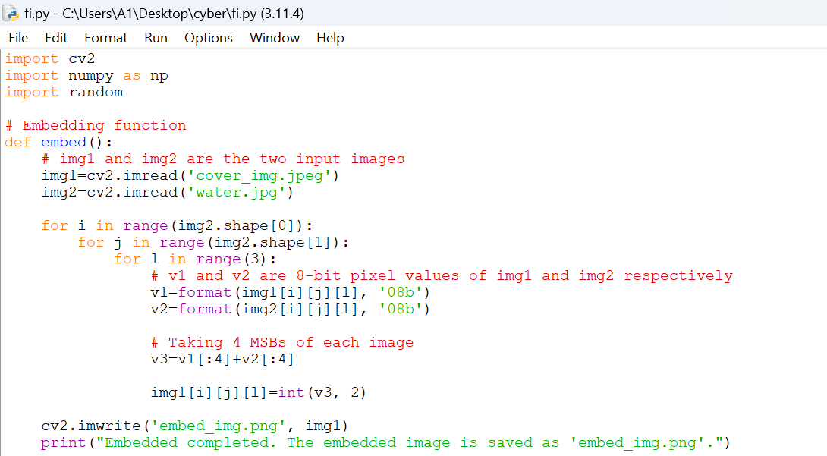
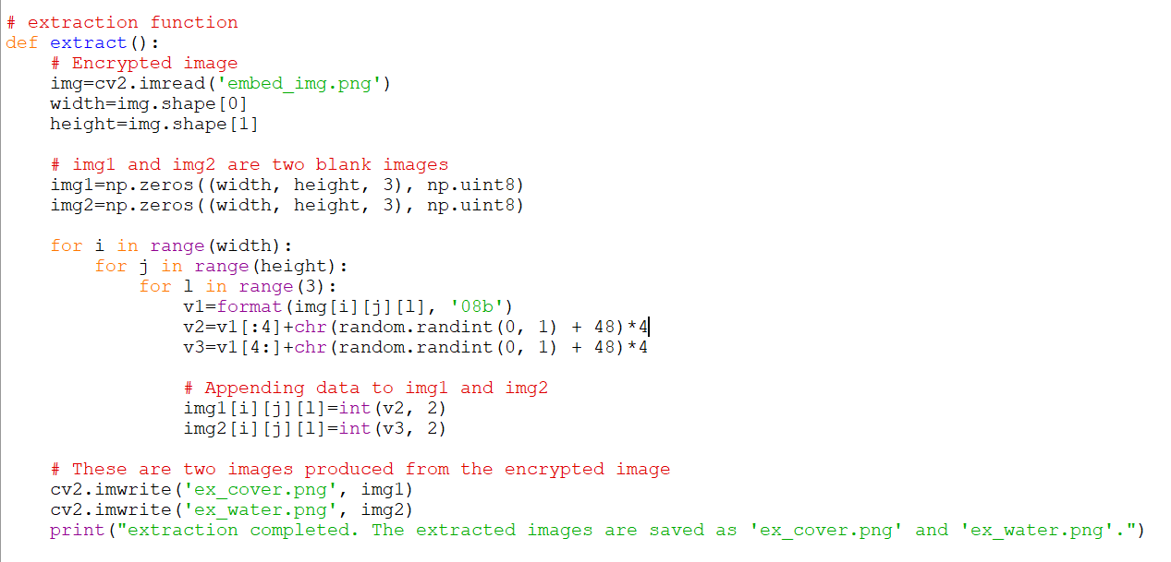

Results
Embedding Function
Extraction Function
Main Function

